Slide 1
Exercise A
University Homepage
2025/10/09
HUANG Jiahui, 44251017

Slide 2
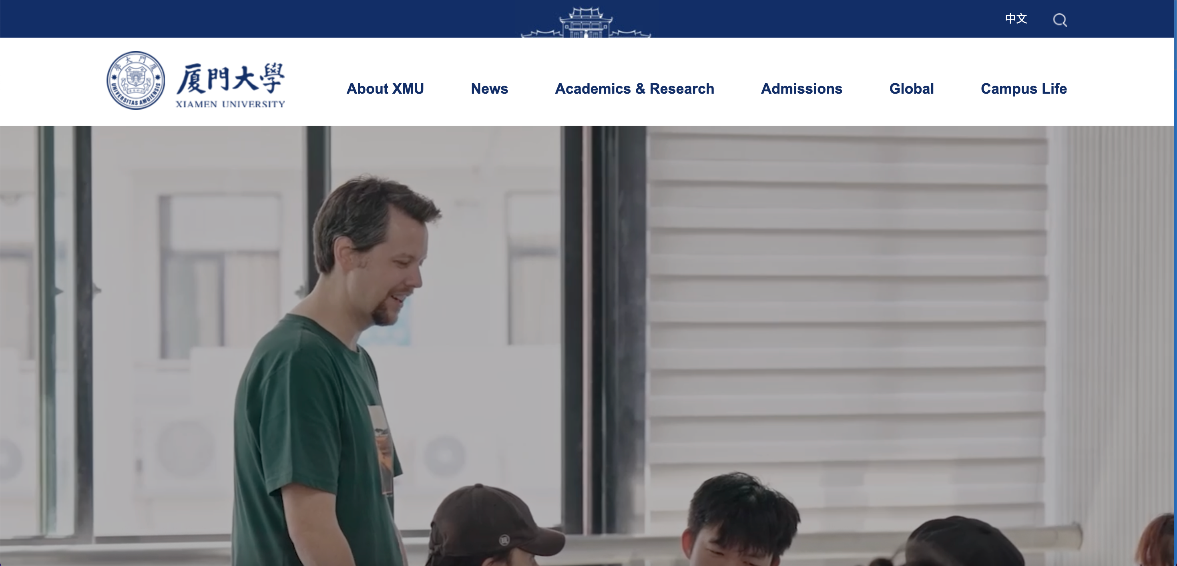

Elements that constitute a valuable UX
Useful – helpful and informative
Branch and Bound guarantees optimality in solutions for problems that satisfy certain conditions, ensuring that the best possible solution is found.

Slide 3
Elements that constitute a valuable UX
Usable
Branch and Bound guarantees optimality in solutions for problems that satisfy certain conditions, ensuring that the best possible solution is found.

Slide 4
Elements that constitute a valuable UX
Findable
Branch and Bound guarantees optimality in solutions for problems that satisfy certain conditions, ensuring that the best possible solution is found.

Slide 5
Elements that constitute a valuable UX
Credible
Branch and Bound guarantees optimality in solutions for problems that satisfy certain conditions, ensuring that the best possible solution is found.

Slide 6
Elements that constitute a valuable UX
Accessible
Branch and Bound guarantees optimality in solutions for problems that satisfy certain conditions, ensuring that the best possible solution is found.

Slide 7
Elements that constitute a valuable UX
Desirable
Branch and Bound guarantees optimality in solutions for problems that satisfy certain conditions, ensuring that the best possible solution is found.

Slide 8
Thank You

